Slide 1

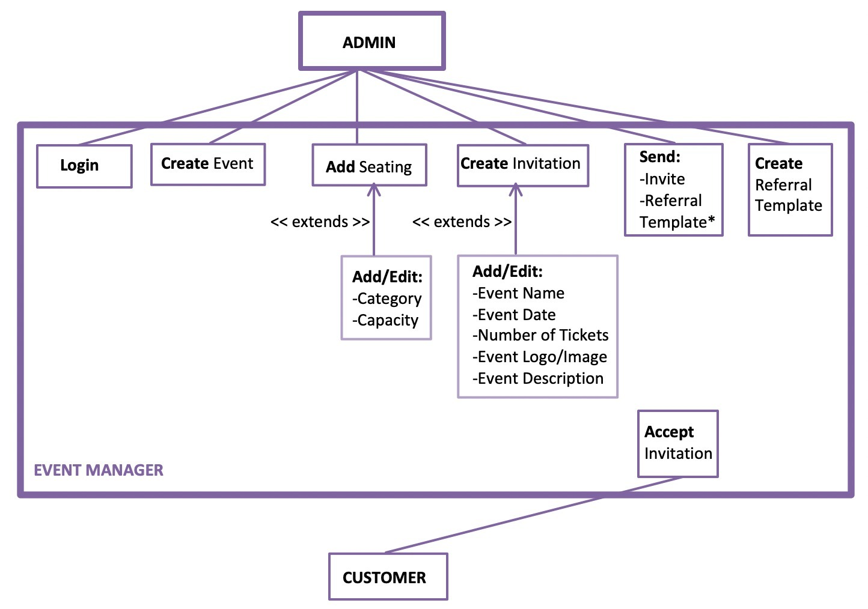
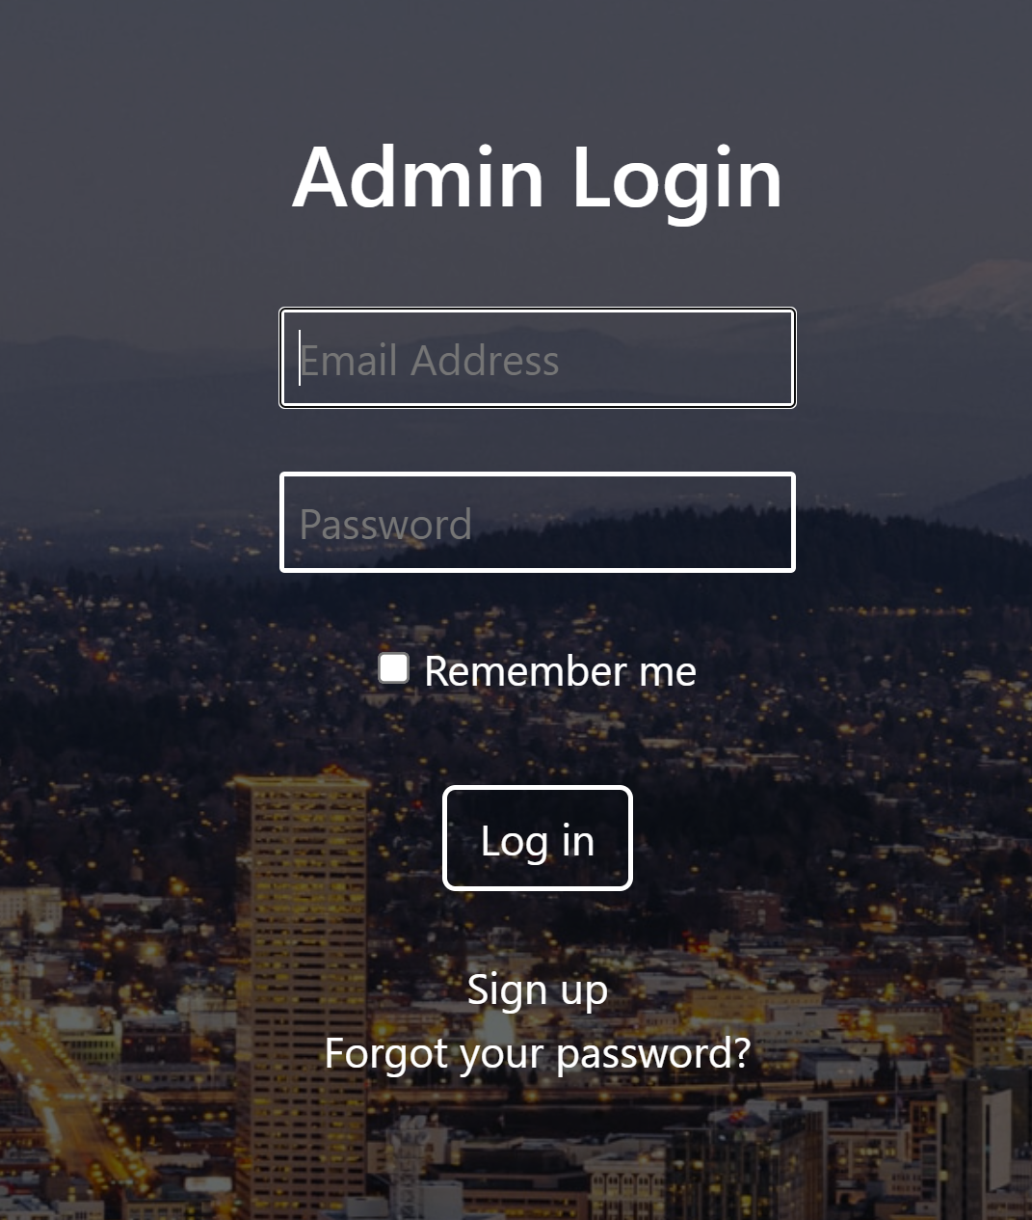
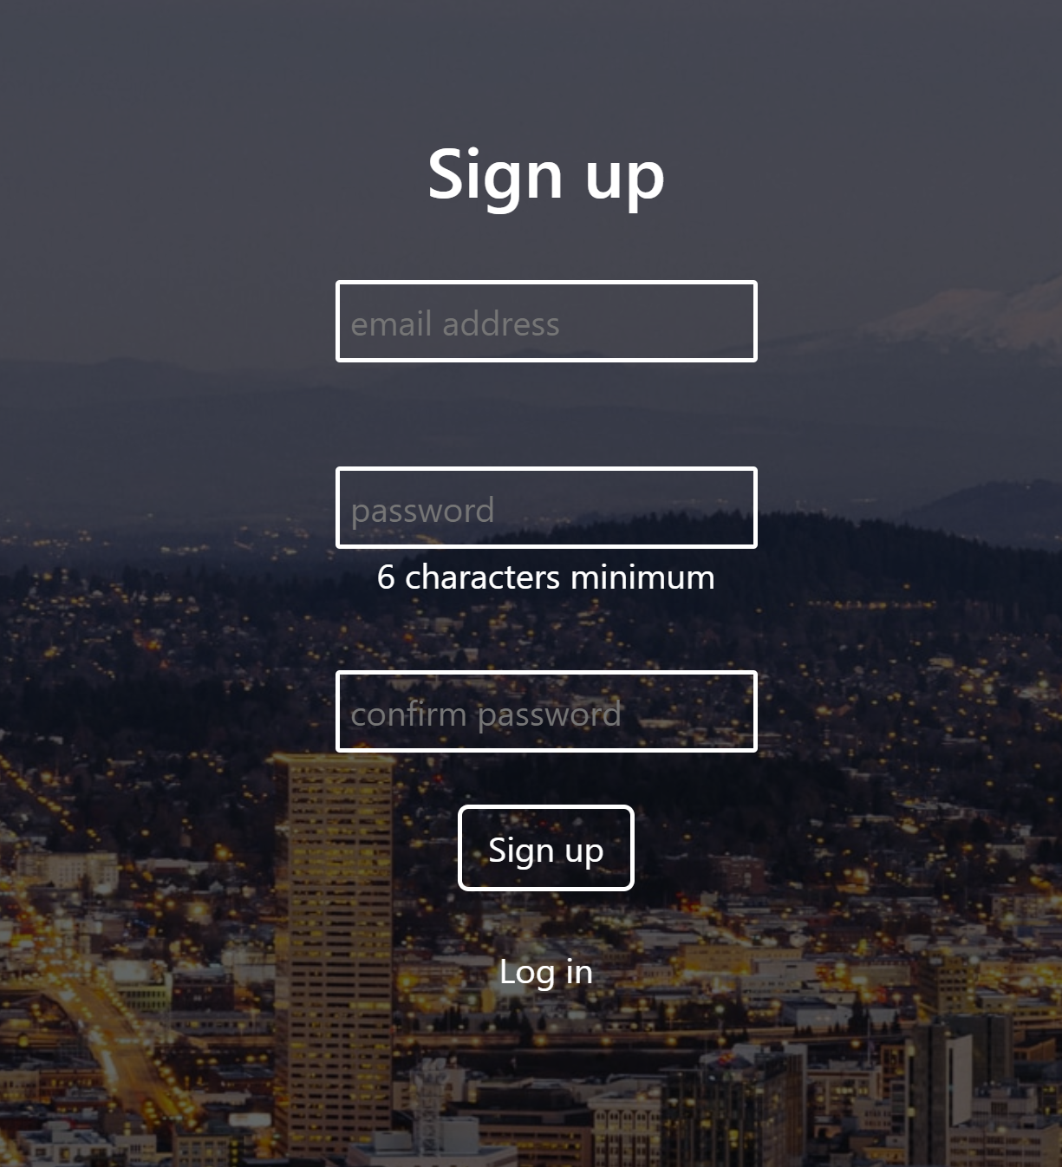
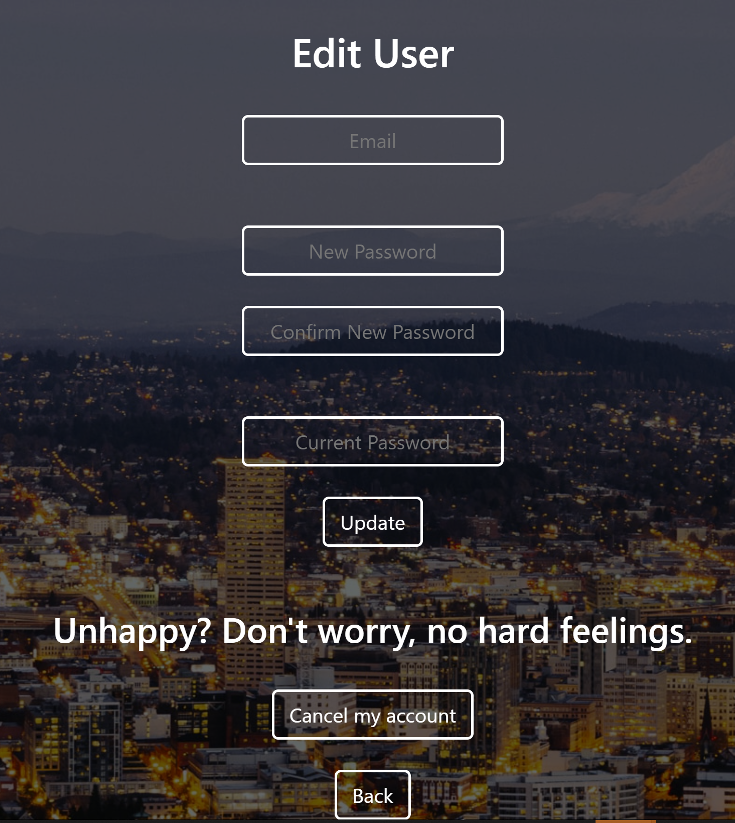
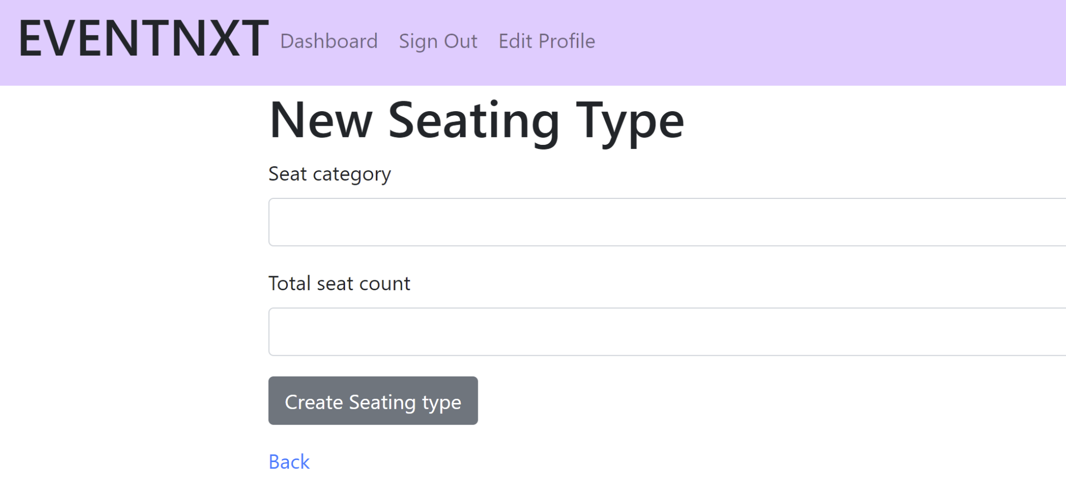
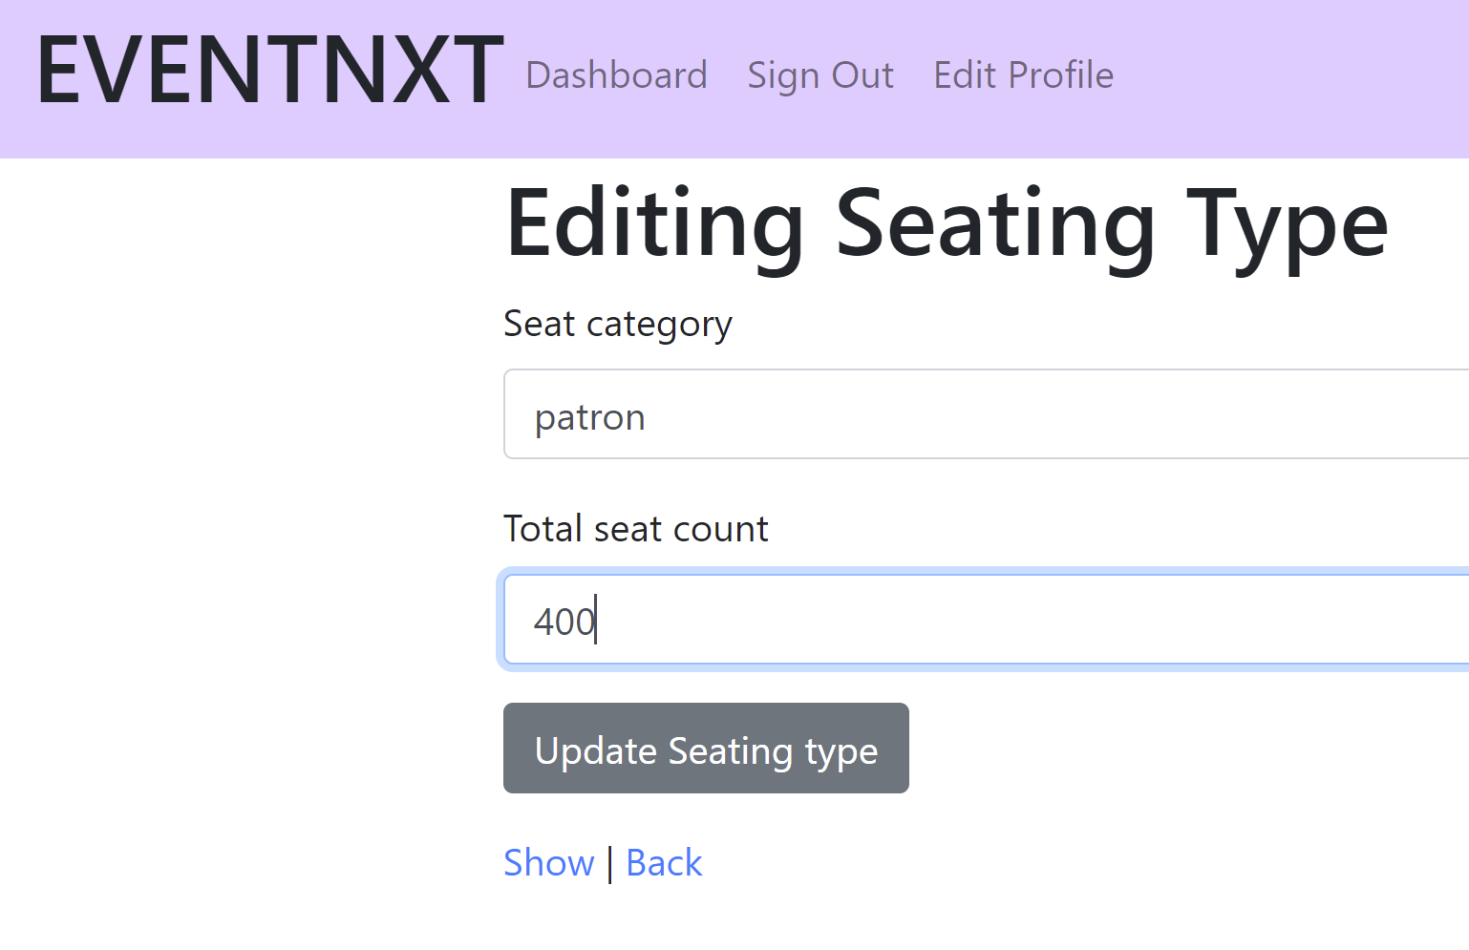
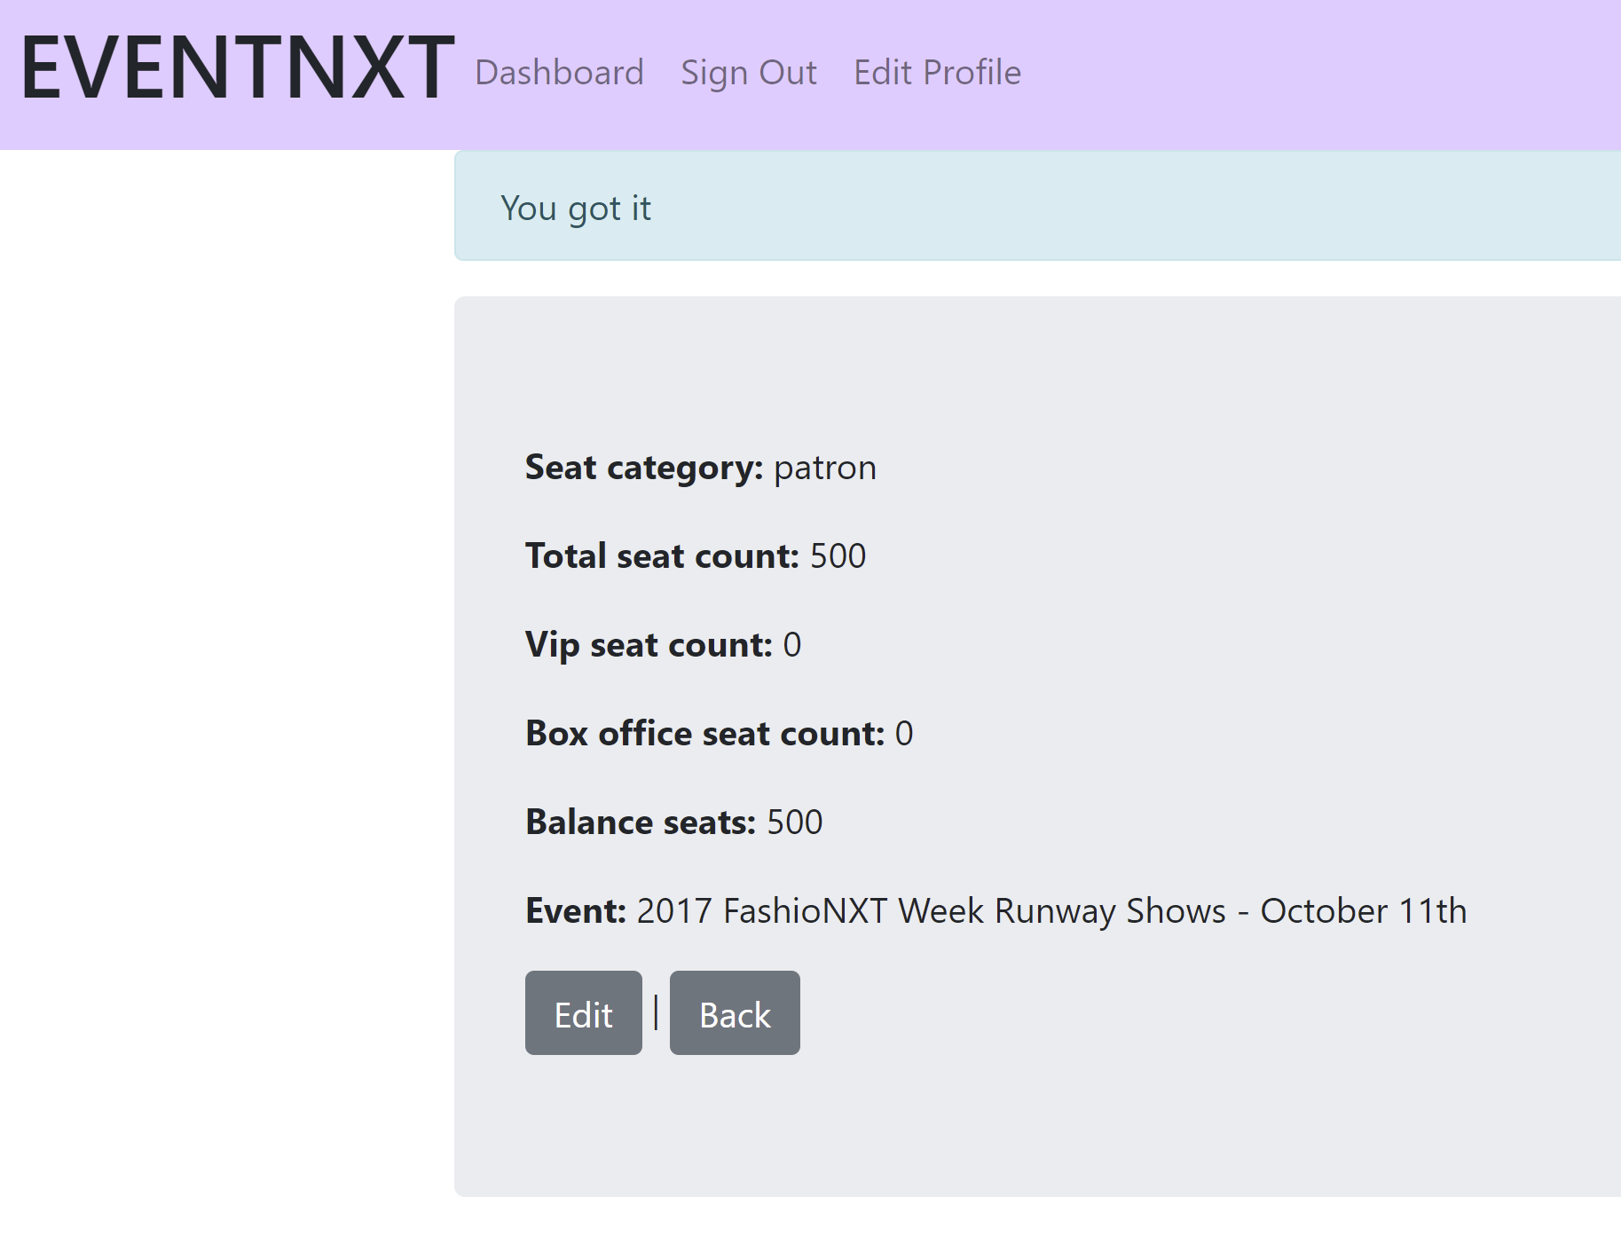
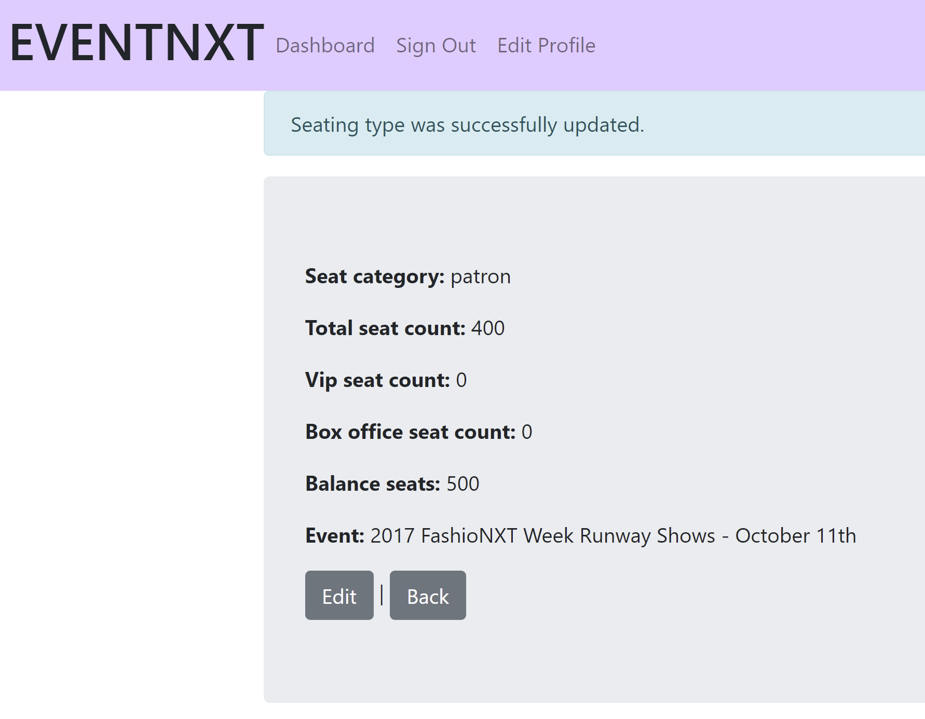
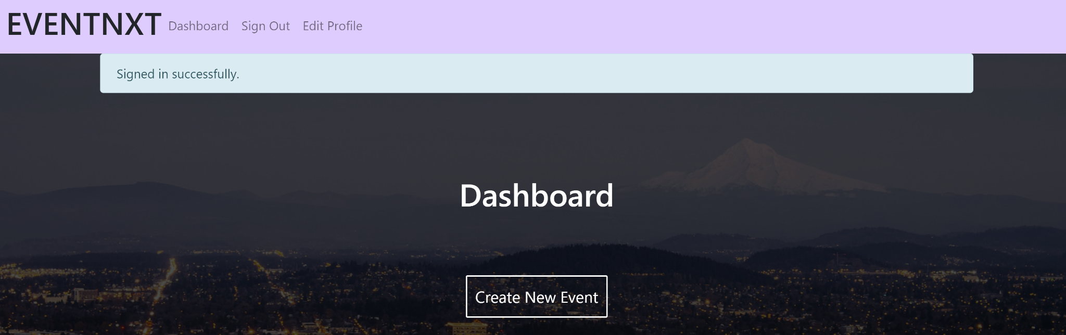
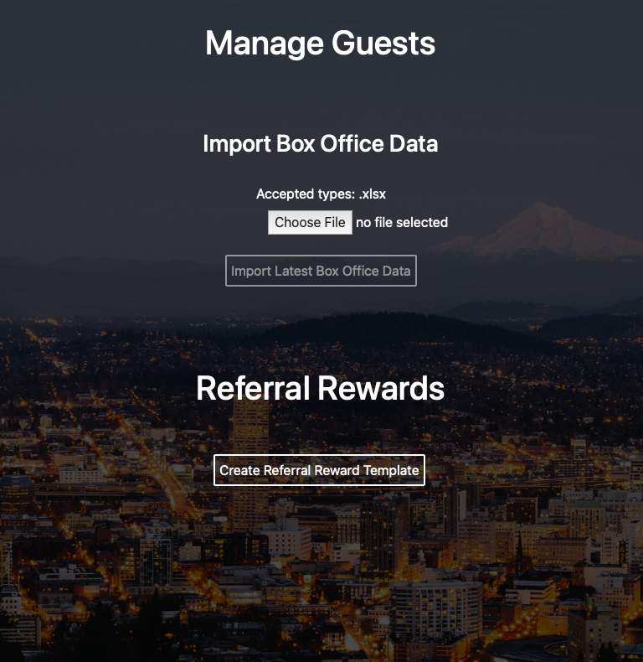
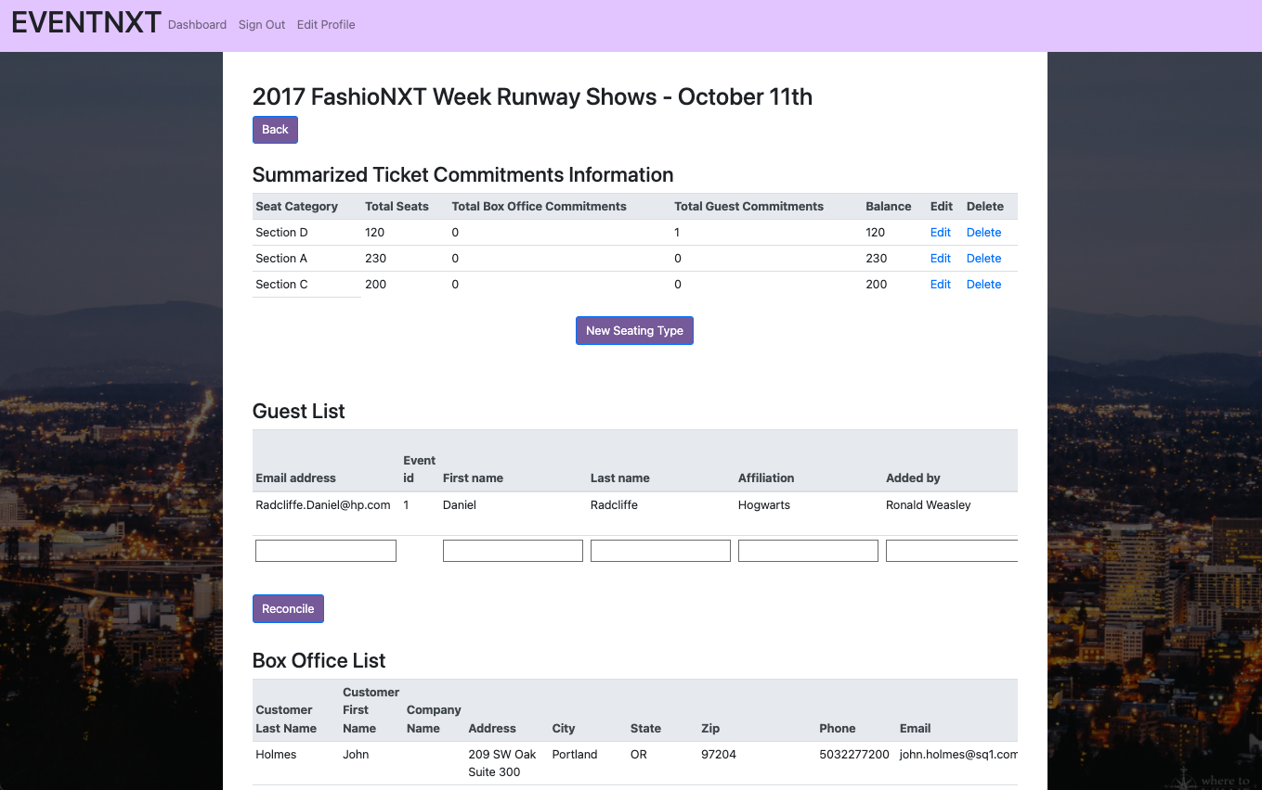
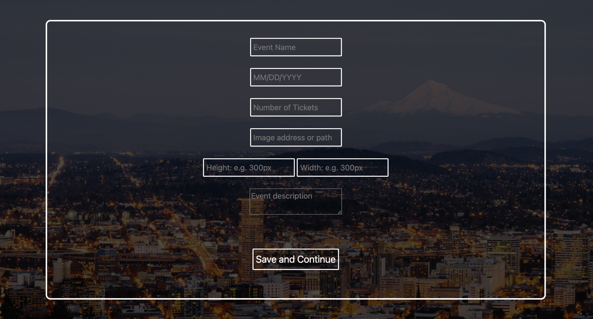
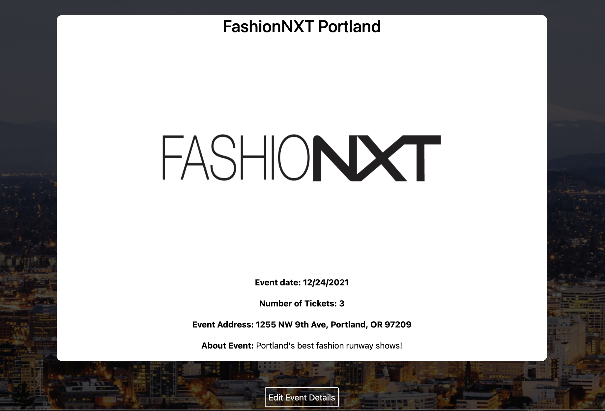
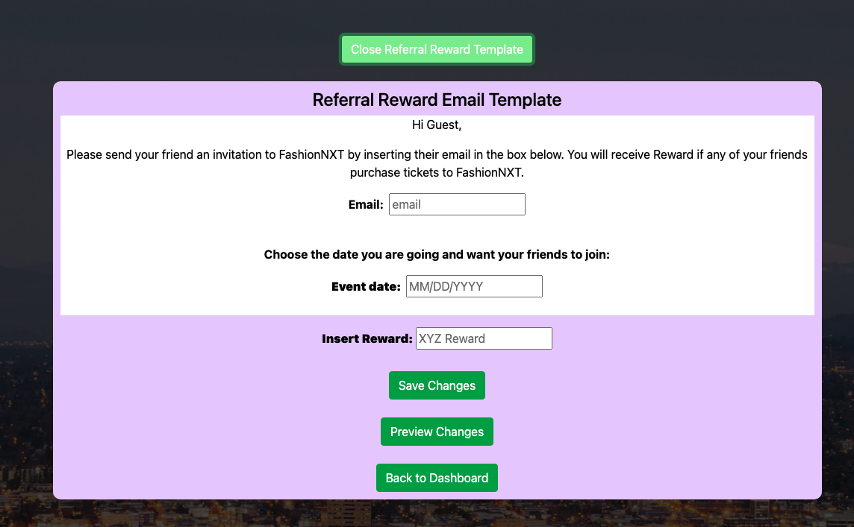
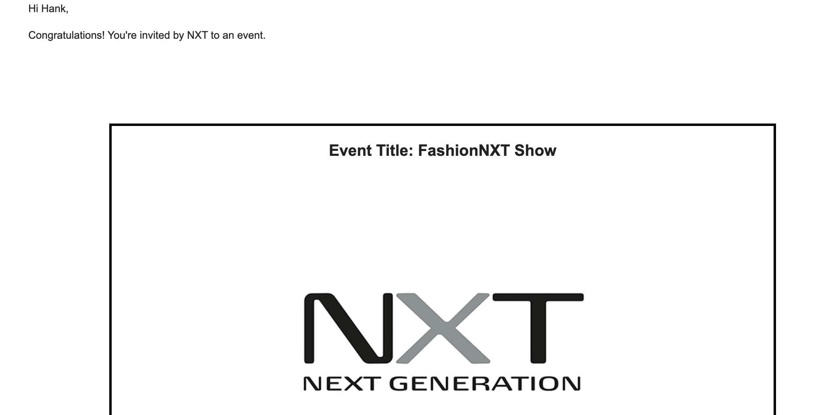
Event Guest List Automation
Asees Sidhu, Leon Lin, Sunayna Ray, Jiyoon Hwang, Dharmendra Baruah, Pavankumar Prakash Kakkanavar, Suma Katabattuni, Sukanya Sravasti
Dept. of Computer Science and Engineering, Texas A&M University
Introduction
Working Flow Diagram
Our Customer: FashionNXT, a globally recognized company focusing on merging fashion and technology.
Our Goal: Manage box office sales and guests list using google spreadsheet, and edit/send RSVP/Referral email to customers.
Our Team: SoftwareSetSails
Our Distinguished Features:
(1) RSVP Invitation Cards.
(2) Manage Guest Lists and Box Office Sales.
(3) Edit Seating types.
(4) Referral Rewards.
Our Project: ‘Event Guest List Automation’ is a SaaS web application using Ruby on rails and deployed on Heroku and with Agile development.
Admin Login/Signup Page and Dashboard
Edit Seating Types
Admin can create new seating type.
Admin can Sign up or Login to access Dashboard and can edit users.
Admin can edit seating types.
Manage Guest Lists and Box Office Sales
Admin can create new events on Dashboard.
Event and RSVP Creation
Can create customized invitation card by inserting image.
Admin can manage Guests and VIP guest response form.
Referral Rewards
Can check the card contents preview.
Admin can write custom referral reward email template for guests
Conclusion
Customers can receive invitation email.
We have had a meaningful experience of developing an actual automation system. We improved RSVP and Managing Guests Lists features and added managing Seating types and Referral features in the previous team’s code using ruby on rails in the unified control portal. This project taught us working on agile software development and how to interact with real customers.

